Slide 1
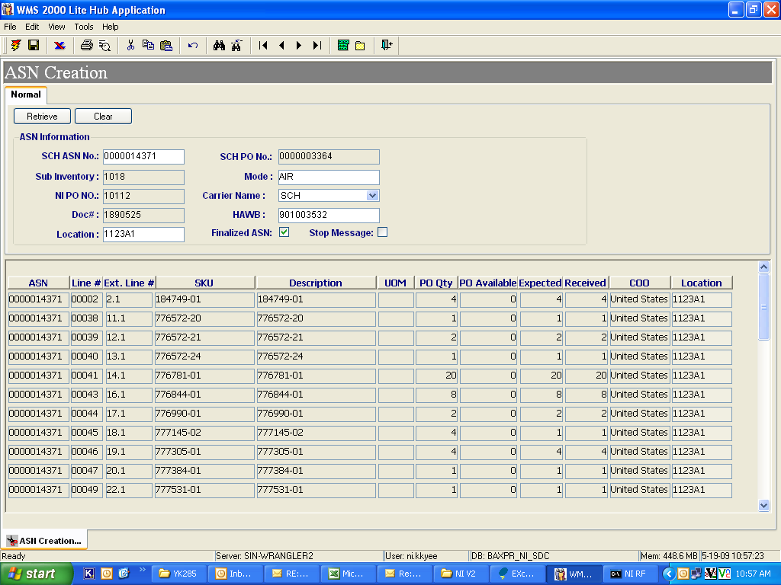
Total Qty Expected : 114
Total Qty Received : 114

